Slide 1
The Hunt for an ideal Student Life
This Project is done by :
-Mouna Hmani
- Khalil Boughzou
- Youssef Khezami
About the dataset files
."survey_responses.csv" : this file contains independent variables about students and their responses to the main questions.
."surveyquestionsmeta.csv" : this file contains meta questions or sub-questions related to the main questions asked in the survey.

Slide 2
Goal Statement
We aim to Understand the psychology of students and understand their level of engagement and involvement in activities have a relation with their level of stress and satisfaction with their student life. This dataset consists of Student Responses to the survey about Ideal Student Life and key factors that are important in student life.

Slide 3
The dataset can be used to answer key questions such as : 1)What factors lead to Stress, More Participation, More Interaction, More Satisfaction? 2)What factors lead to increased stress among the students? 3)What are the most important attributes for an Ideal Student Life?
Problem statements

Slide 4
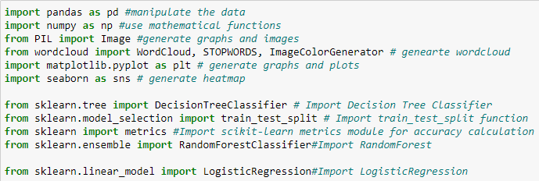
These are the libraries we’ve used in our Project followed by their respective usage.
Logistic Regression
Random Forest

Slide 5

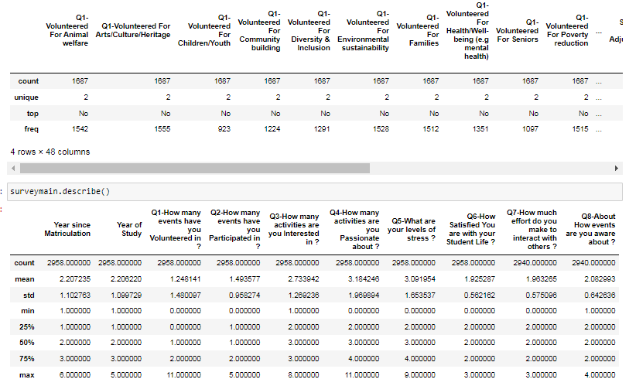
Once we have imported the data,we start the cleaning process
because it is essential to clean and transform data before building any
visualizations or reporting. This is an essential step in building quality
Visualizations, models and interpretations.
First, we are going to delete the unnecessary column response_id because it is irrelevant to the models we intend to use.
Now, we will check the summary for outliers.

Slide 6
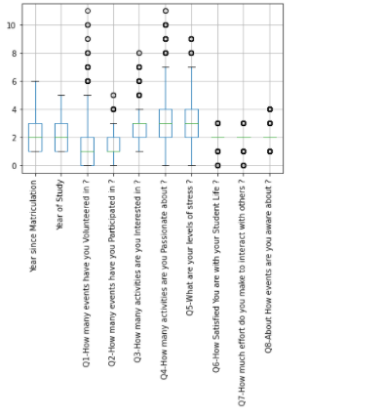
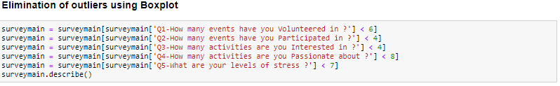
There seem to be outliers within our data since the maximum values are far bigger than Mean+Std: We need to check using BOXPLOT
Indeed, we have outliers that we need to eliminate since they increase the variability in our data, which decreases statistical power. Consequently, excluding outliers can cause ourresults to become statistically significant.

Slide 7
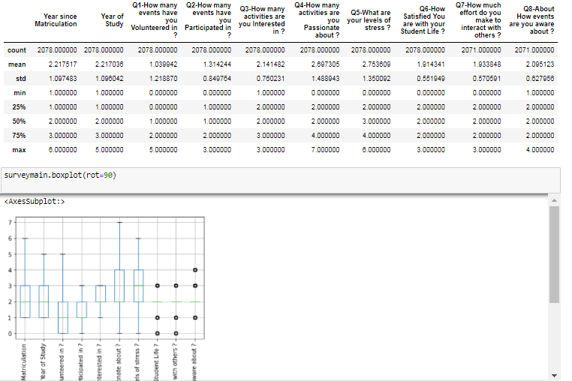
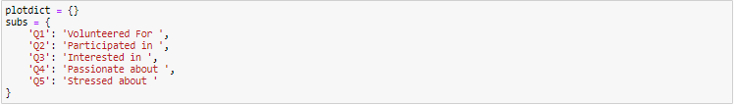
The outliers have been deleted and our data is clean of outliers
Now since the question names are too long, we will shorten them to be able to put them as labels in our graphs

Slide 8
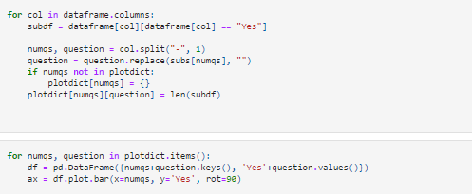
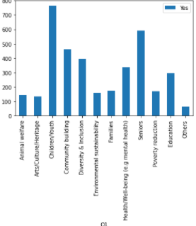
Now, we’re ready to answer our first problem : What are the most activities done, most volunteered in , most interested in , most passionate about and what stress students the most ?
Plot1:Volunteered in
-Plot 1(Acivities) : Children/Youth is the most 'sub activity" done by students and Arts/Cluture/Heritage are the least.

Slide 9
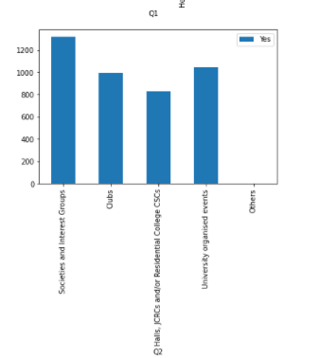
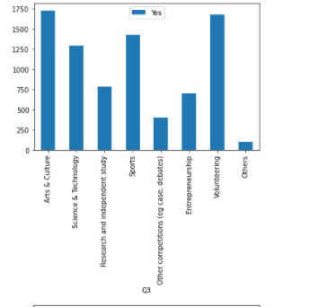
PLOT2
-Plot 2(Volunteering):Students volunteer in Societies and Interest Groups the most and Q2 halls, JRCS and/or Residential College CSCs.
PLOT3
-Plot3(Interests): Students are mostly interested in arts and culture and volunteering and least interested in other competitions.

Slide 10
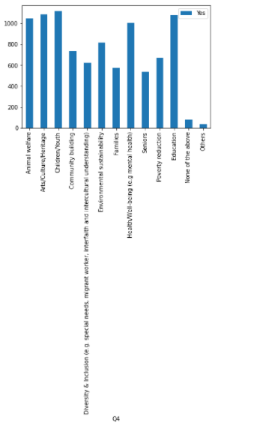
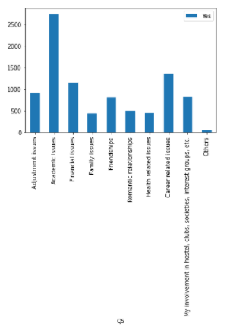
PLOT4
-Plot4(Passion): Over 1000 students are passionate about animal weflare,Art/cluture/heritage,Children/Youth, health and well-being, Education.
PLOT5
-Plot5 (stress): More than 2600 which constitute 95,2% of the students have academic issues causing stress.

Slide 11
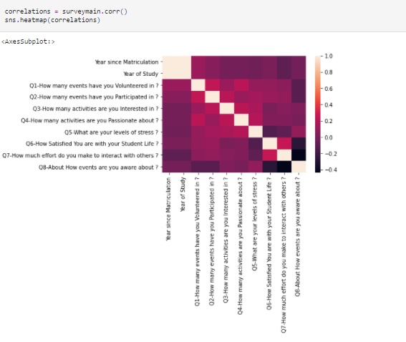
Now that we’ve answered our first problem, we moved on to the second: Which factors lead to more stress?
-The correlation between the answers for the respective questions are considered low, since most of
the correlation values are between [-0,4;0,4].
-Correlation between stress and satisfaction is -0,11 which is negative which is something rational.

Slide 12
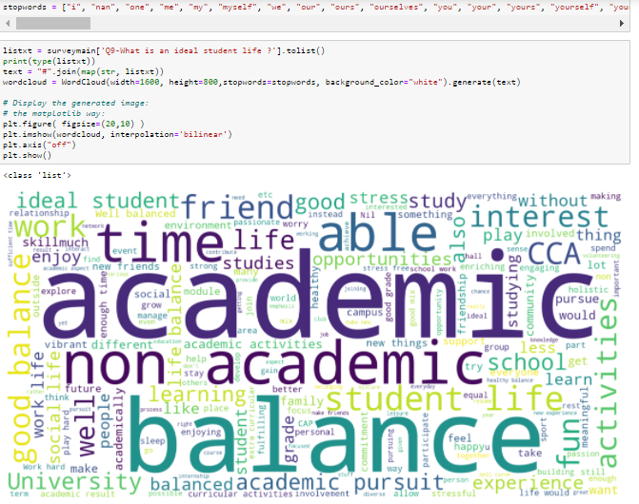
Now we will proceed to our last problem: What are the most important attribute to an ideal student life?
For this, we will use a WordCloud to find the most used words in the feedback column in order to train our data.
-Here is a WordCloud of the text of every student in the ideal student column.
-As we can see the most used words are the ones with the bigger fontsize.
-For eg : Students mostly use balance;academic;non academic;time ; friend.

Slide 13
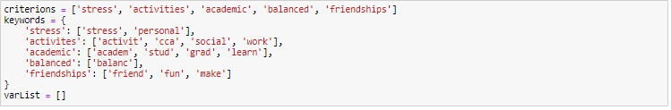
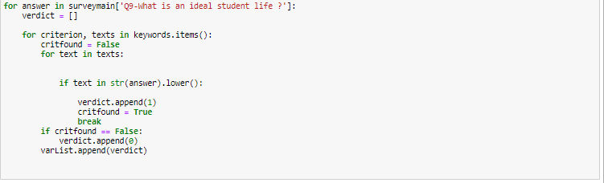
Now, we will mine the text.
We divided the ideal student life into 5 attributes/categoties: Stundents are interested in doing activites +/ making friendship +/ their academic knowledge +/ a stress-free life or a balanced student life.
-Based on the WordCloud we got the most used words , classified and added them into lists for every attribites.
Each student will have a correspondant vector [activities;volunteering;interests;passion;stress] with 5 binary variables:
For eg: if he is only interested in stress and the feedback says something like
'I want a stress free life',his vector would be [0;0;0;0;1],
if he''s interested in volunteering , doing activities and a stressfree life, his vector would be [1;1;0;0;1].

Slide 14
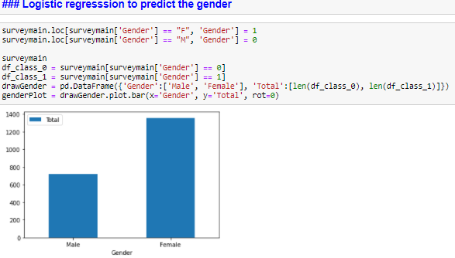
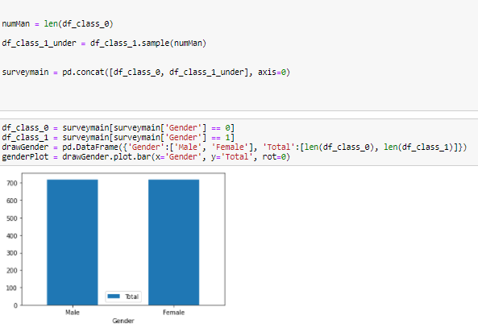
Now, we will try to predict whether a person is a male or a female using Logistic regression and Random Forest
Interpretation: The dataset contains far more female persons than male persons therefore we need to clean it in order to balance the data.
Interpretation: With the adequate methods, we balanced our data at 720 persons for each gender using sampling.

Slide 15
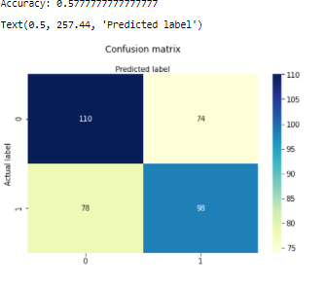
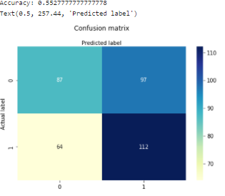
Through the logistic regression, we tried to predict the gender using the other variables. The accuracy of the model is estimated at 57,7% which is not a strong accuracy. This might be justified by the fact that other factor are not a strong determinant of gender, indeed the correlation between the gender and all the other activities is weak if not negligeable (this can be seen in the correlation matrix above).
Through the random forest, we tried to predict the gender using the other variables.
The accuracy of the model is estimated at 55,5 % which is not a strong accuracy. This might be justified by the
fact that gender is not a strong determinant of different other factors, indeed the correlation between the gender and
all the other activities is weak if not negligeable (this can be seen in the correlation matrix above).

Slide 16
Summary:
Throughout this analysis we aimed the factors that cause an ideal Student life . Using a public set of surveys extracted from studetns from National University from Singapore, we aim at visualize the importance of each sub factor in relation with the main factor as well as factors between them. We started our analysis by cleaning our data, by removing unnecessary words and symbols, replacing column names, stemming, vectorization and text mining. Then to get informed about the Data content, we used word clouds and a Bar charts for Data visualization. We then proceeded to use 2 classification models:Random Forest and Logistic Regression.

Slide 17
Summary:
Each model was trained, tested, and evaluated by calculating the accuracy of its predictions. Finally, comparing all of our models we've come to undertand that the accuraccy of our models are not strong . This might be justified by the fact that gender is not a strong determinant of different other factors, indeed the correlation between the gender and all the other activities is weak if not negligeable (this can be seen in the correlation matrix above).
Link to the recording !

